Slide 1
Project Name
User Biodata Mangement Web Application

Slide 2
Team Details
Team Name : Dream Team
Team Leader
M.Jenish
Team Members
A .Iyappan
T. Anu Asha
M.Joni Manju
G.Stanly Mary
Notes:
-Add team details with name and qualification,e-mail,phone no and place

Slide 3
User Biodata Mangement Web Application
Introduction
This is going to be a Web application for managing the user bio data . It also helps the users of the college or any other institution to manage his or her biodata.By using the application the user can manage his general details,education details,profile,objective,professional experience,technical expertise and project details,Personal Details.
Procedure
Firstly we created one database
After that we created font end web application for getting information form user input
We created back end coding to auto insert data form fornt end to database
And we stored the user input data to database and also we displayed input data changes in web application
And we gived edit and delete option to the web application to make easy to user
If the user wants to edit or delete data use this options to edit or delete directly form the database

Slide 4

Database Design
User Details
Personal Details
Biodata
Basic Details
Technology Details
Education Details
Experience Details
Notes:
Get the database design from the phpmyadmin or from SRS document

Slide 5
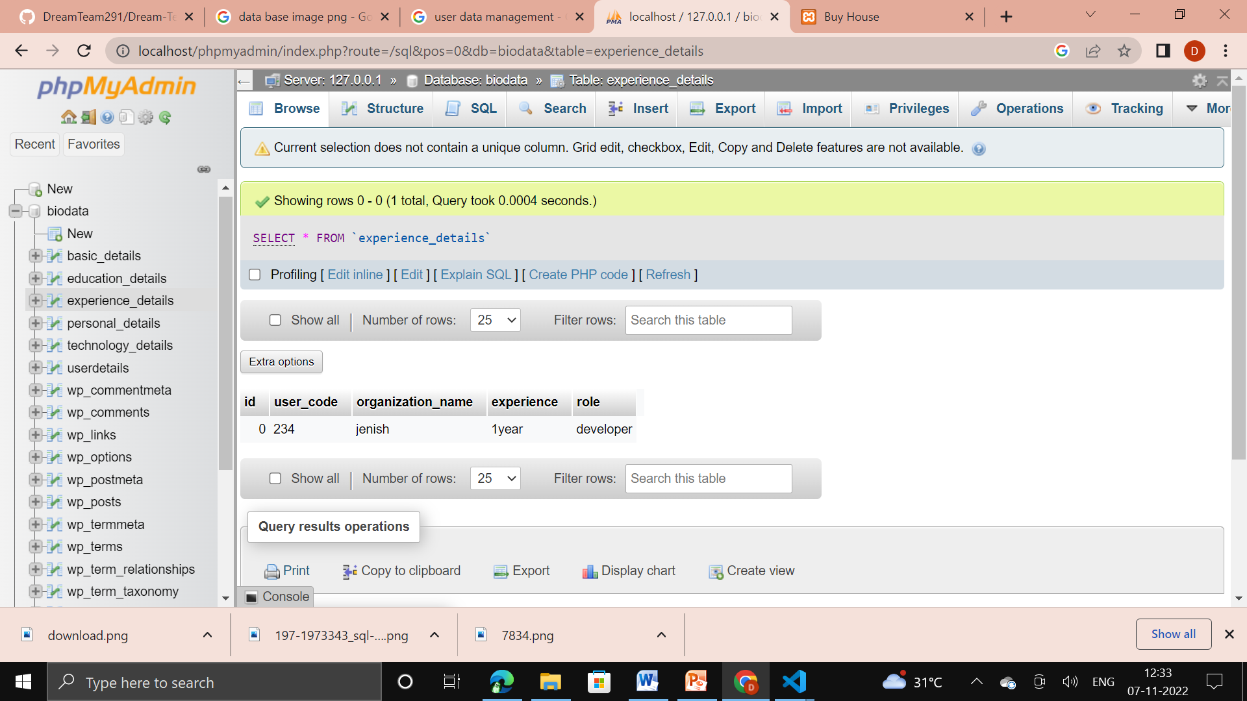

Slide 6
Form Design
SQL Biodata Form Details
USER DETAILS | BASIC DETAILS | EDUCATION DETAILS | PERSONAL DETAILS | TECHNOLOGY | EXPERIECEE DETAILS

Slide 7
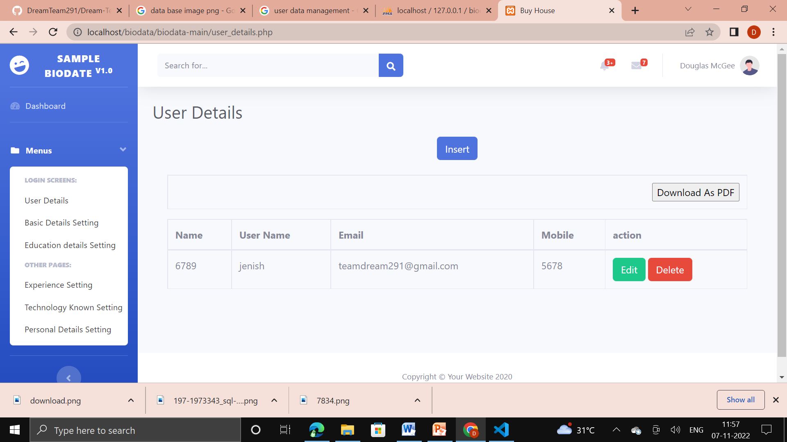
Template Design

Slide 8
TEAM MEMBER -1

Slide 9
Forms & Database Design
Technology details
USER DEAILS
ID | USER CODE | EXPERIENCE TYPE | EXPERIENCE DETAILS

Slide 10
DATABSE DESIGN
Id
Technology details
UserCode
Biodata
Experience type
experience

Slide 11
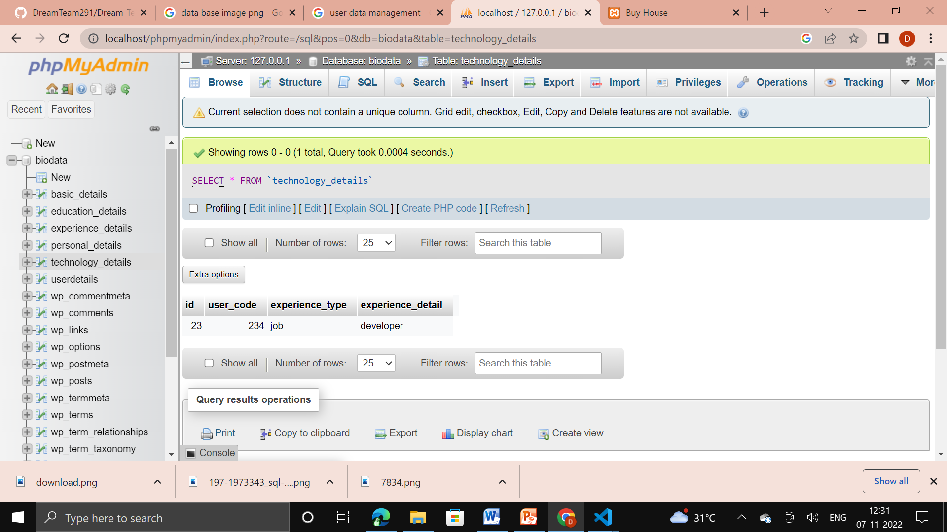

Slide 12
Problem/difficulty Faced
Problem faced the error in displaying in web application page but data was stored in database
Notes:
Explain problem faced

Slide 13
Soluton to the Problem
Re-directing page file name mistake

Slide 14
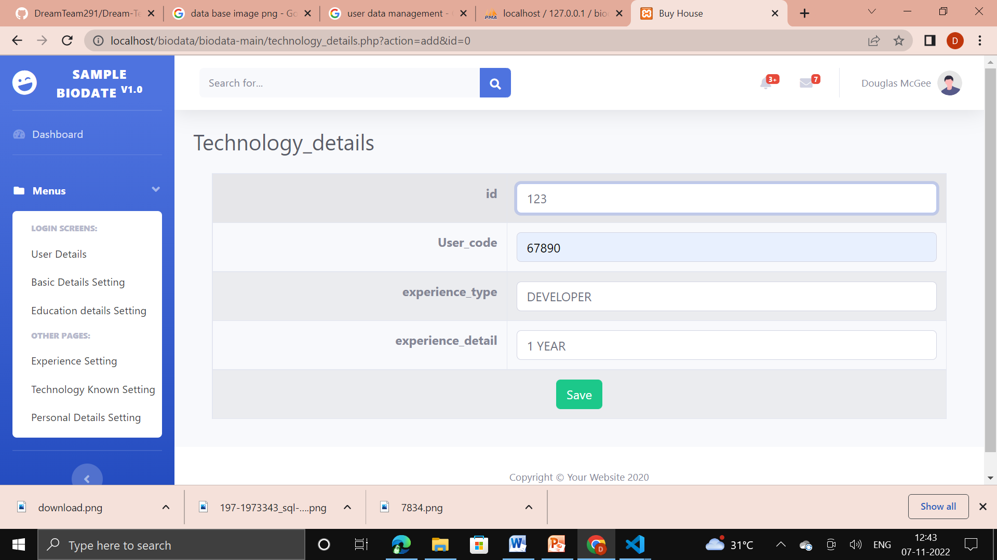

Slide 15
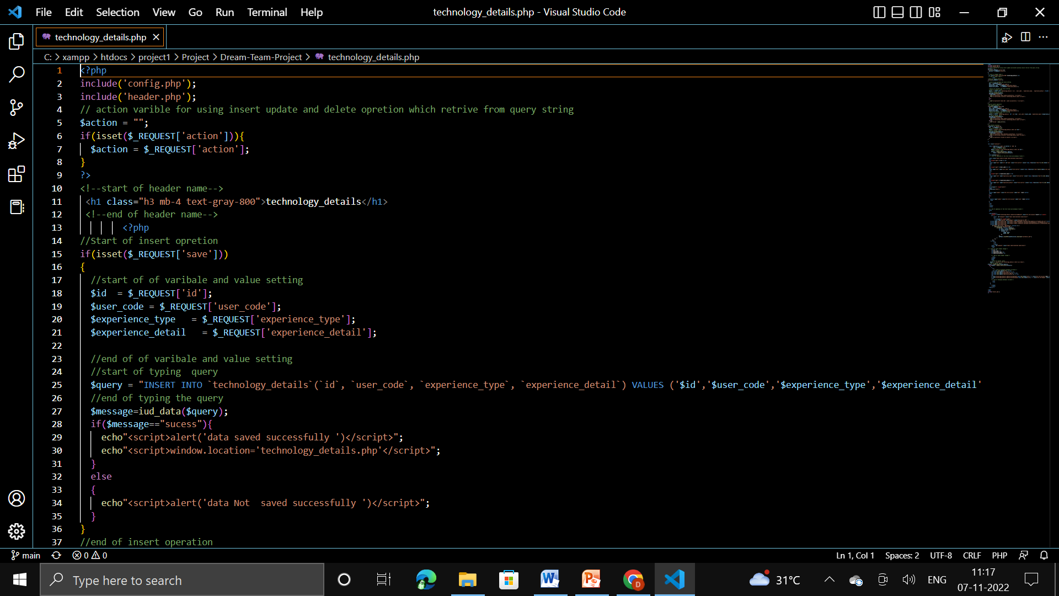
Sample Source code
Notes:
Explain how attained the solution

Slide 16
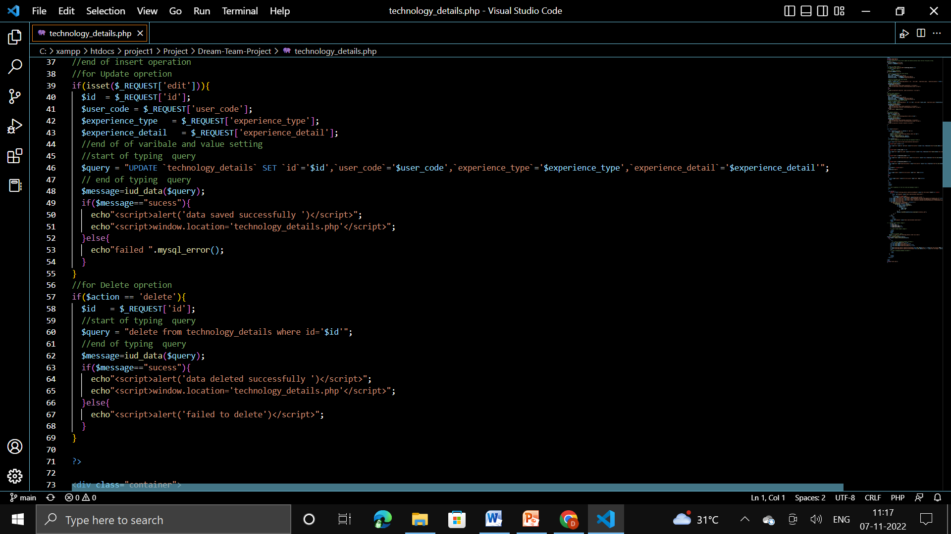

Slide 17
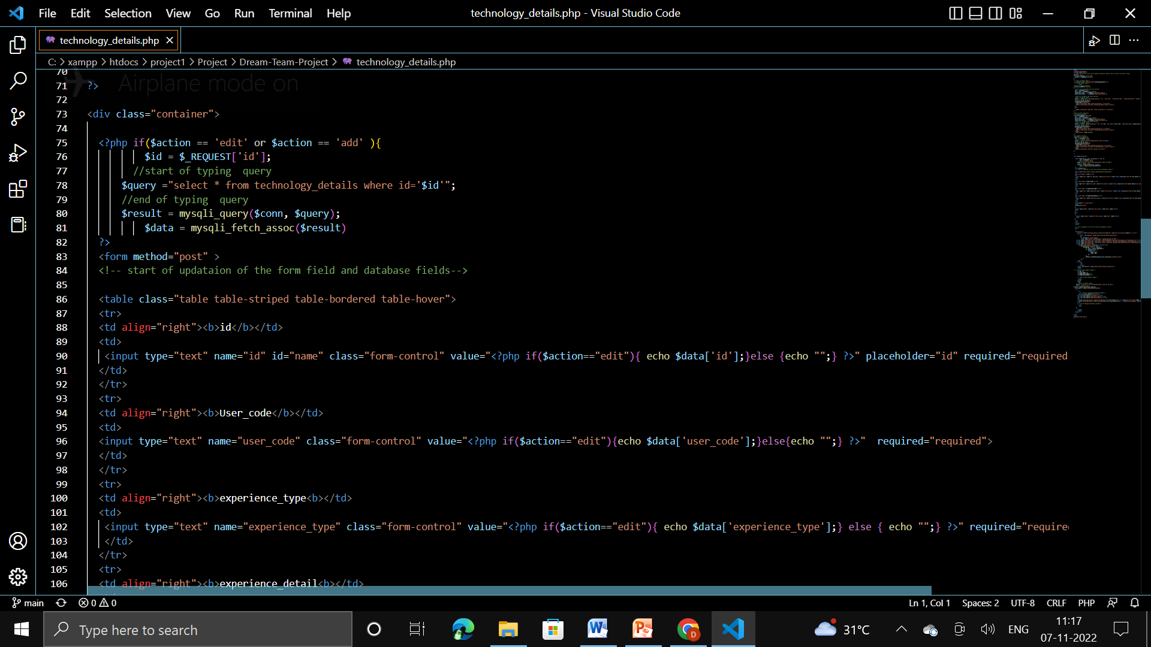

Slide 18
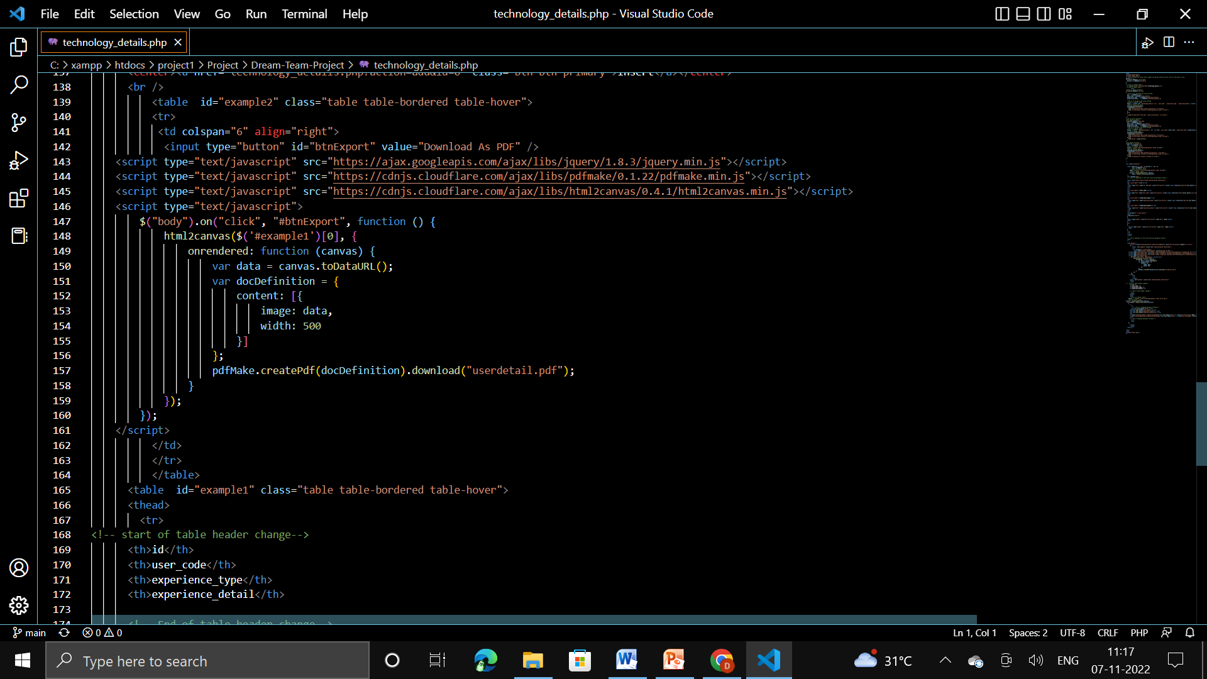

Slide 19
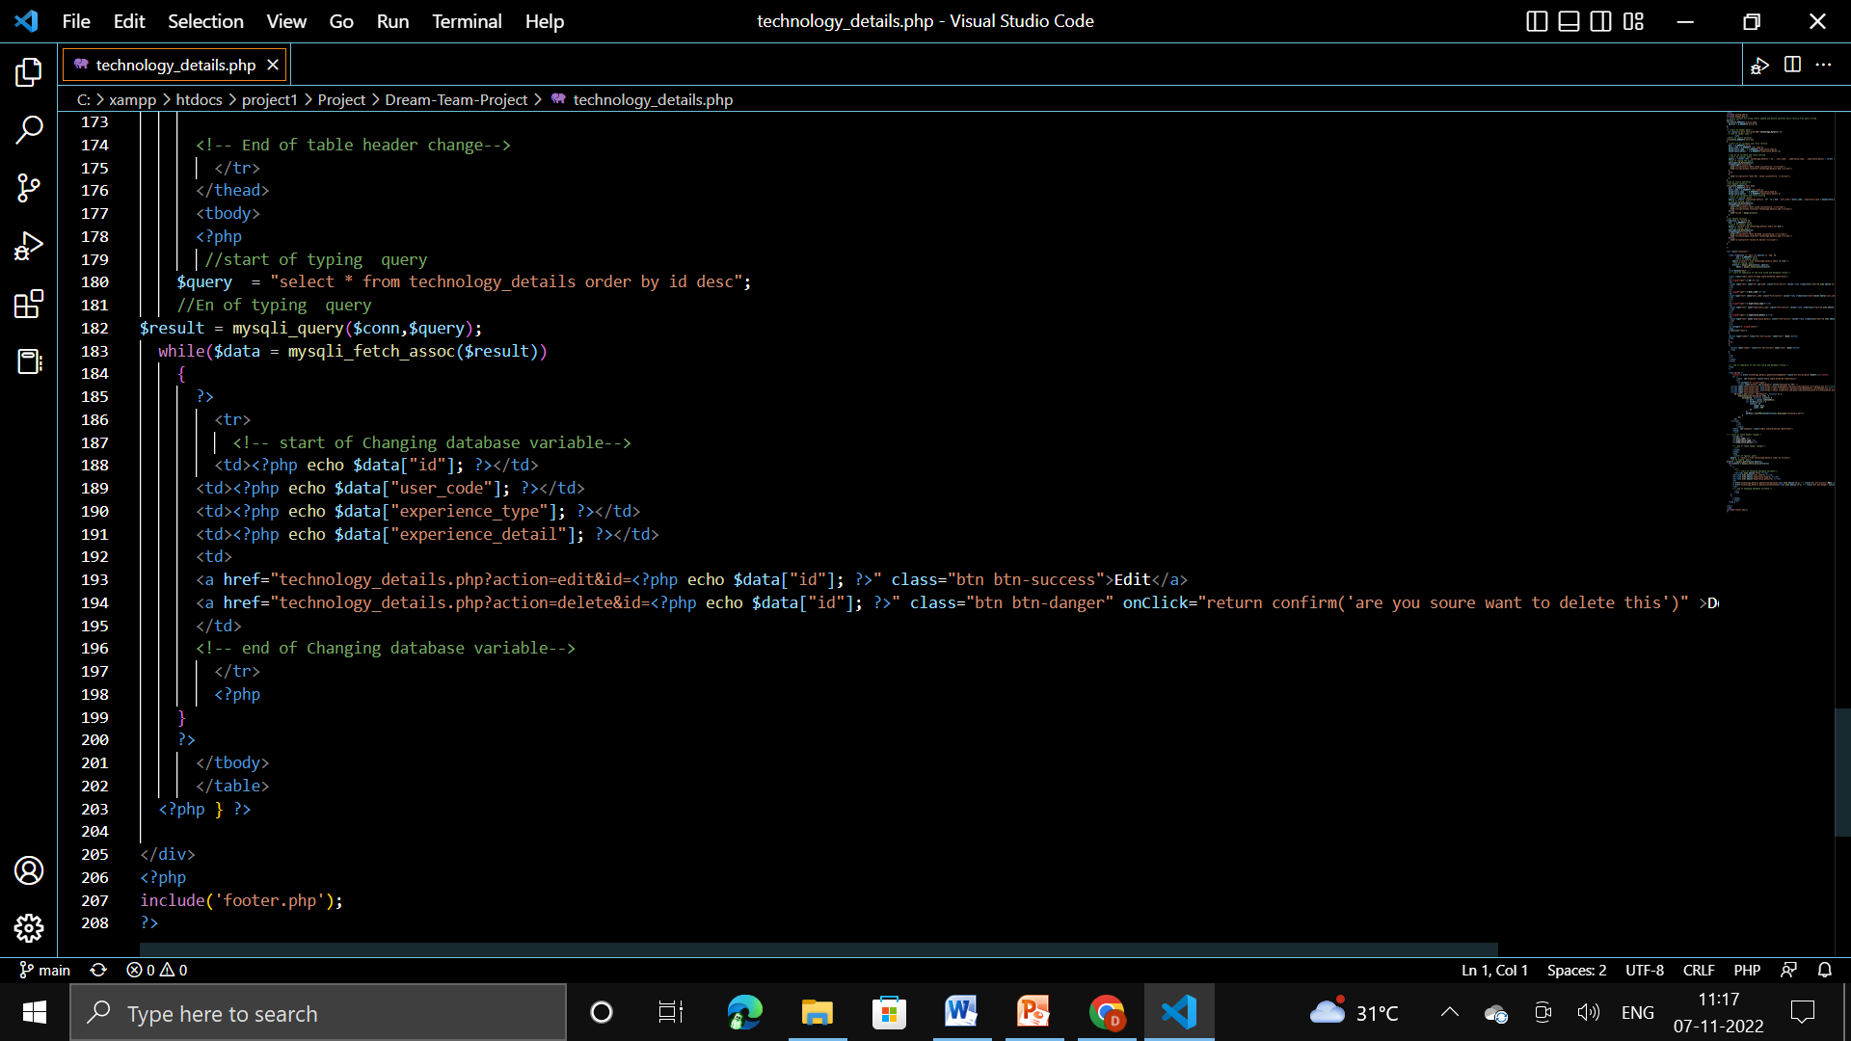

Slide 20
TEAM MEMBER -2

Slide 21
Experience Details
User_code
Organizaton_name
Biodata
Experiece Details
Experience
Role
Notes:
Get the form design from the phpmyadmin or from SRS document

Slide 22
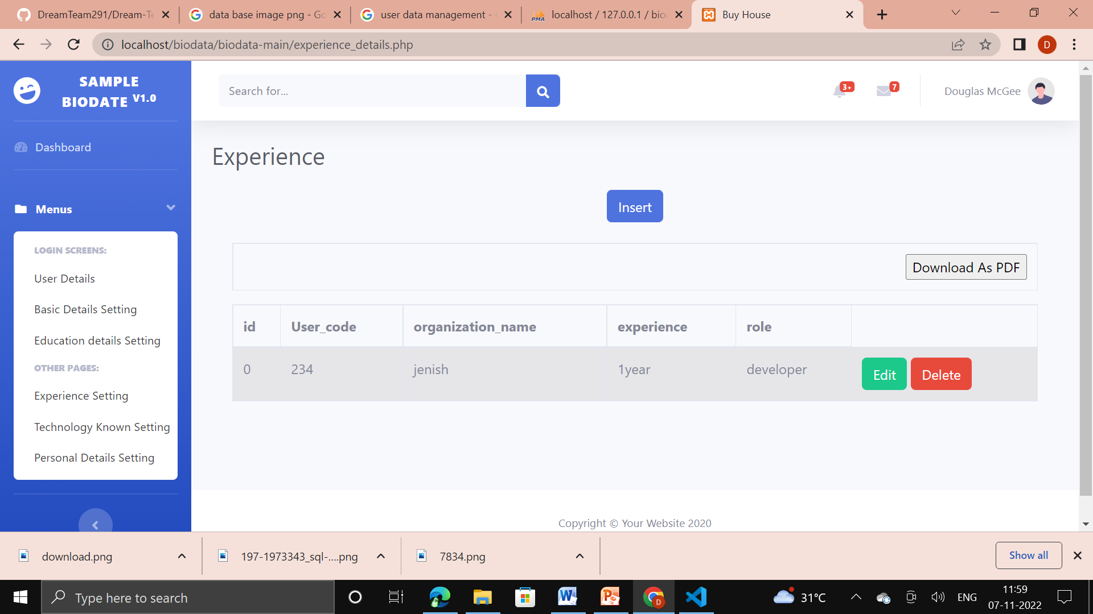

Slide 23
Form Design
Experience details
User_code | Organizaton_name | Experience | Role

Slide 24
Problem/difficulty Faced
Page working perfect but data not saved in database

Slide 25
Solution to the problem
I was missing the key word “where “ in sql comments
Notes:
Explain how attained the solution

Slide 26
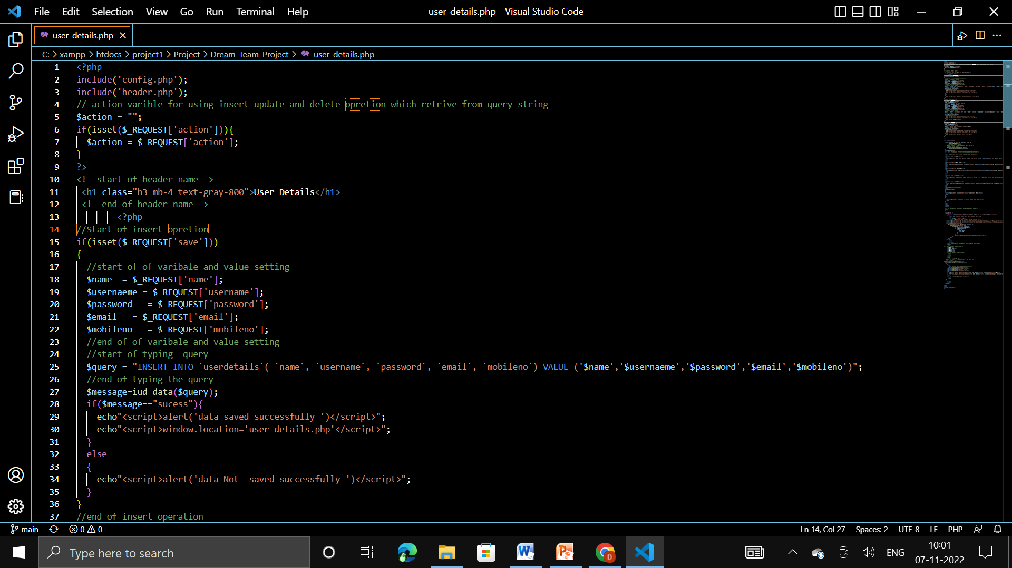
Sample Source code

Slide 27
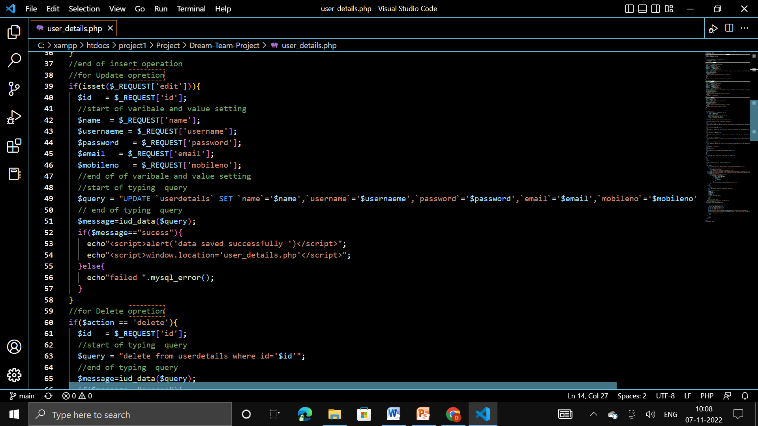

Slide 28
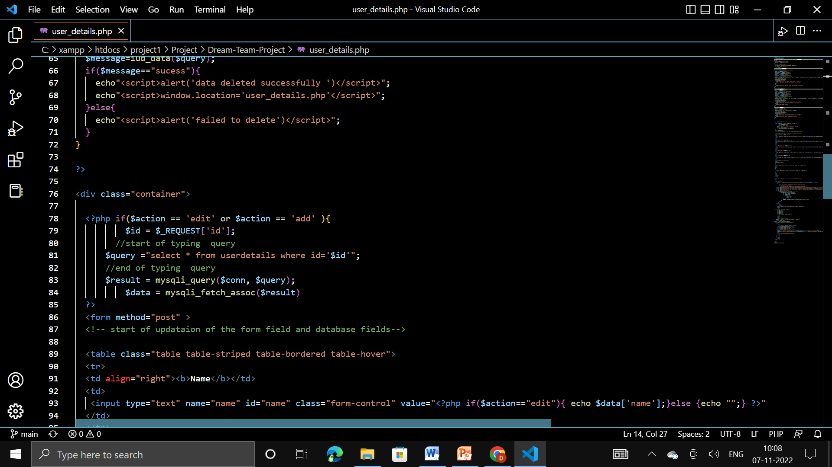

Slide 29
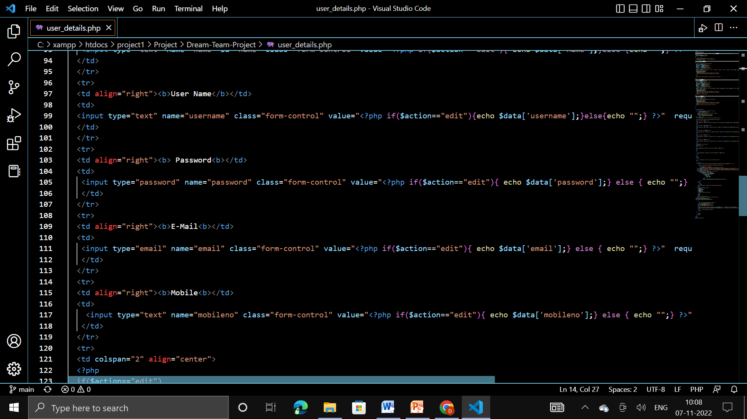

Slide 30
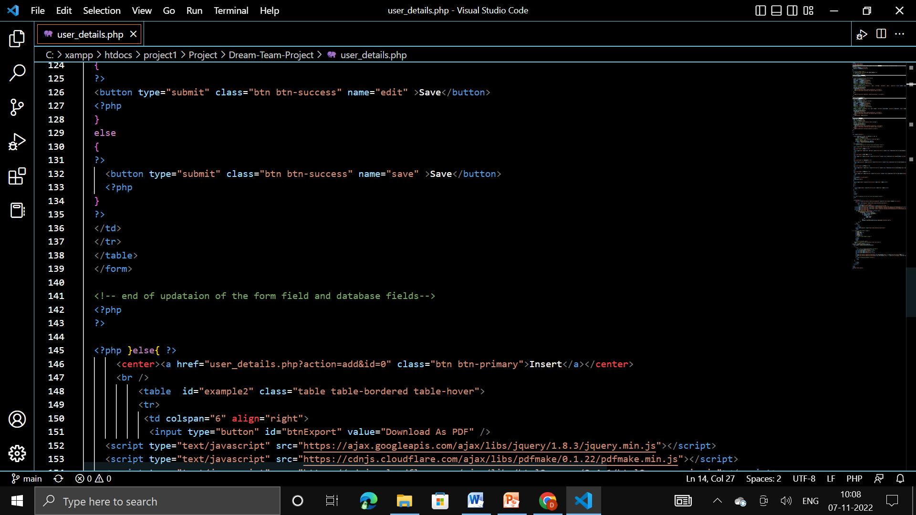

Slide 31
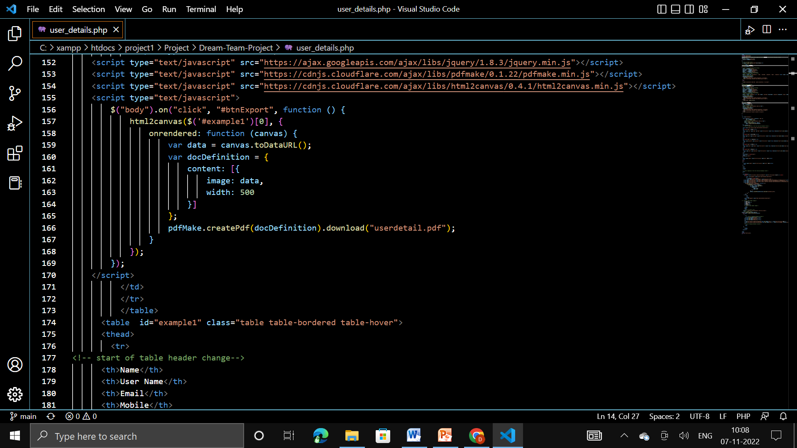

Slide 32
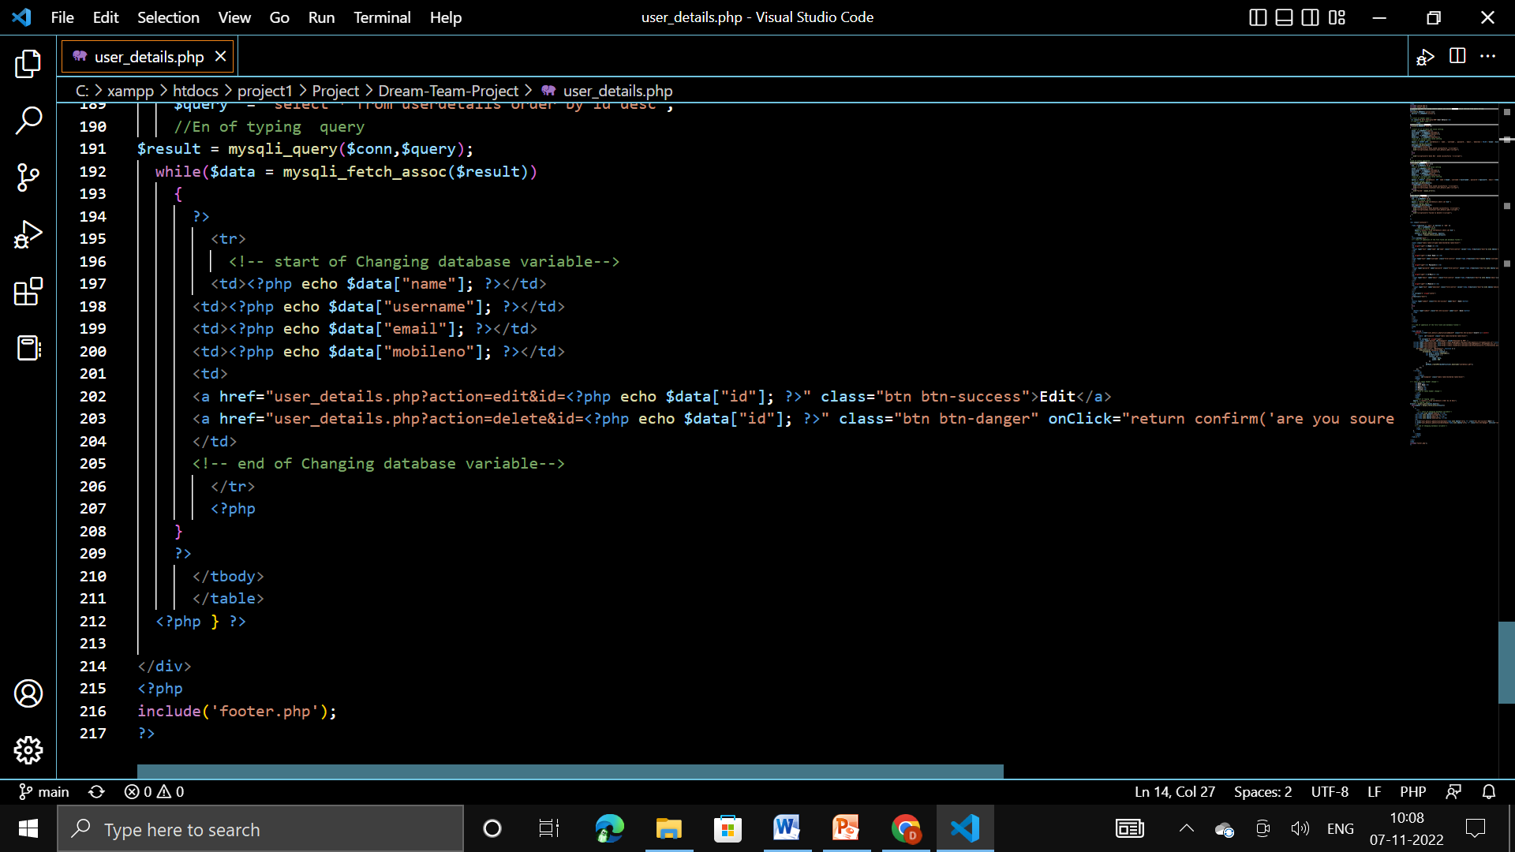

Slide 33
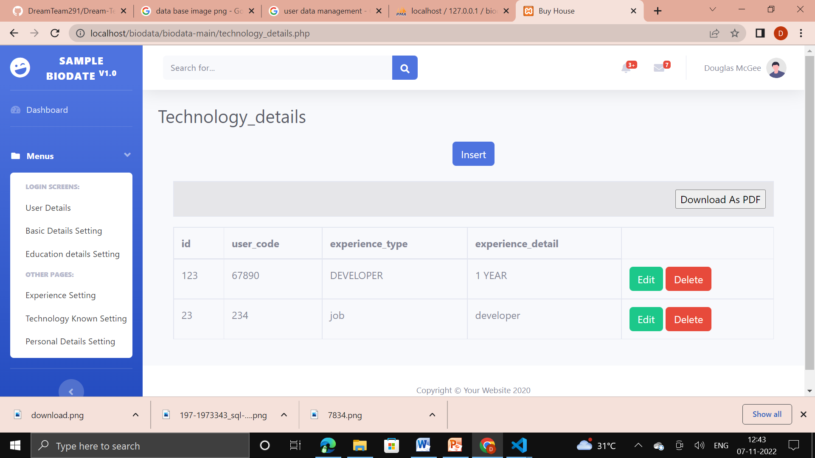

Slide 34
THANK YOU

